Slide 1
Setup of Kumar Lab Long Term Monitoring (LTM) experimental recording apparatus
Last updated: 2021-09-22

Slide 2
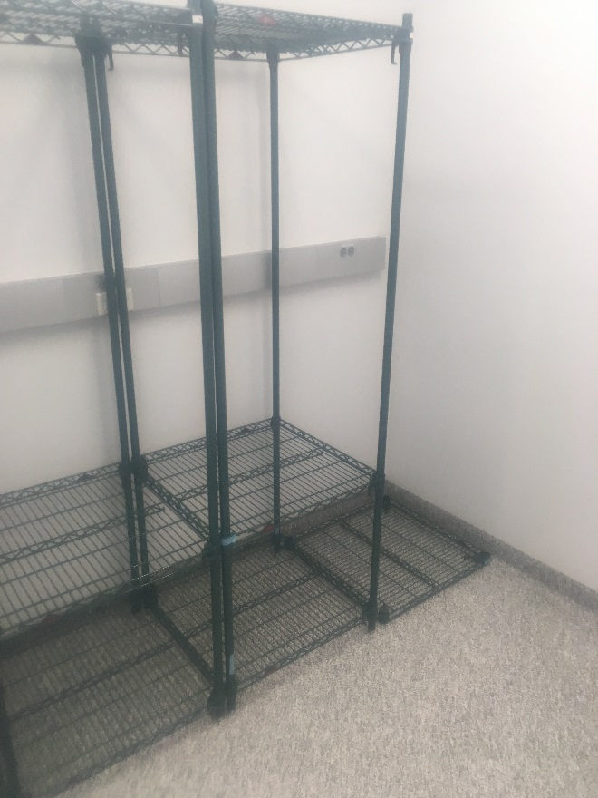
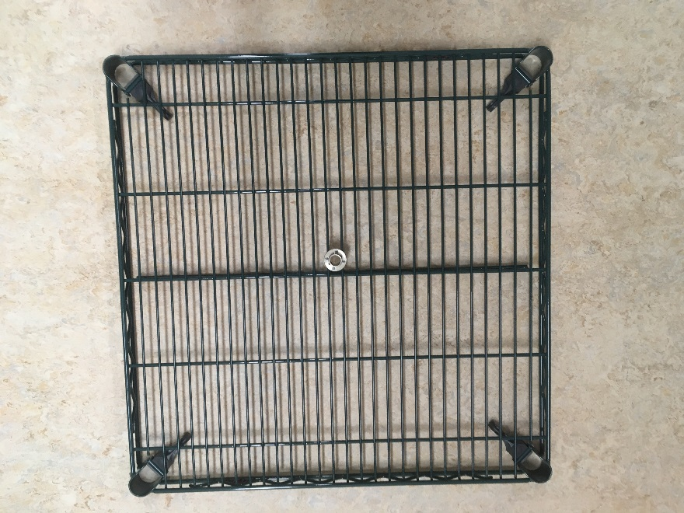
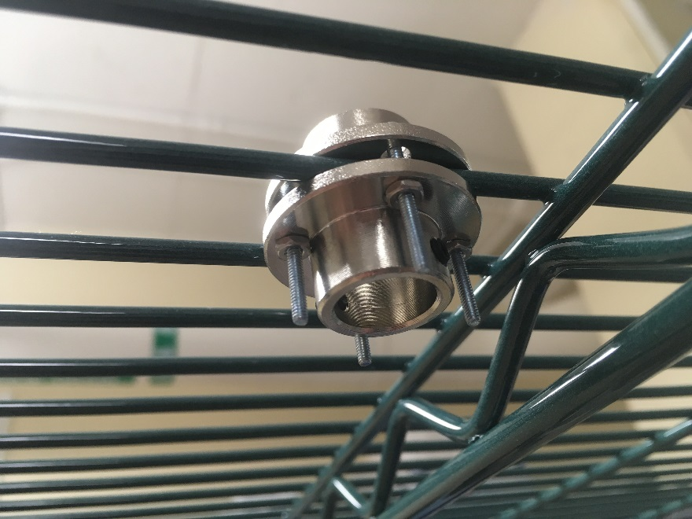
Set Screw
Step 1: Assemble the Metro rack with shelves at 24” (posts are labeled), topmost position and bottommost position.
Step 1a: Either before or after rack assembly, add a pair of flanges to the top shelf, attached to each other with #2 screws and nuts, as shown (add set screws to flanges before attaching them to rack).

Slide 3
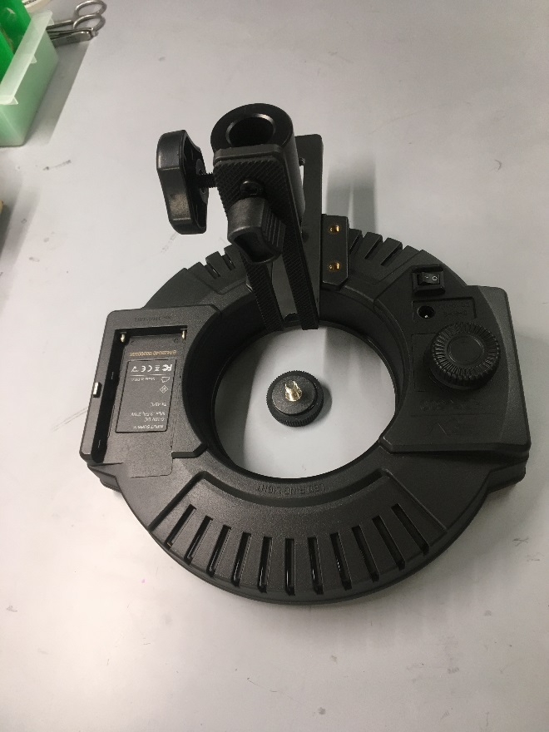
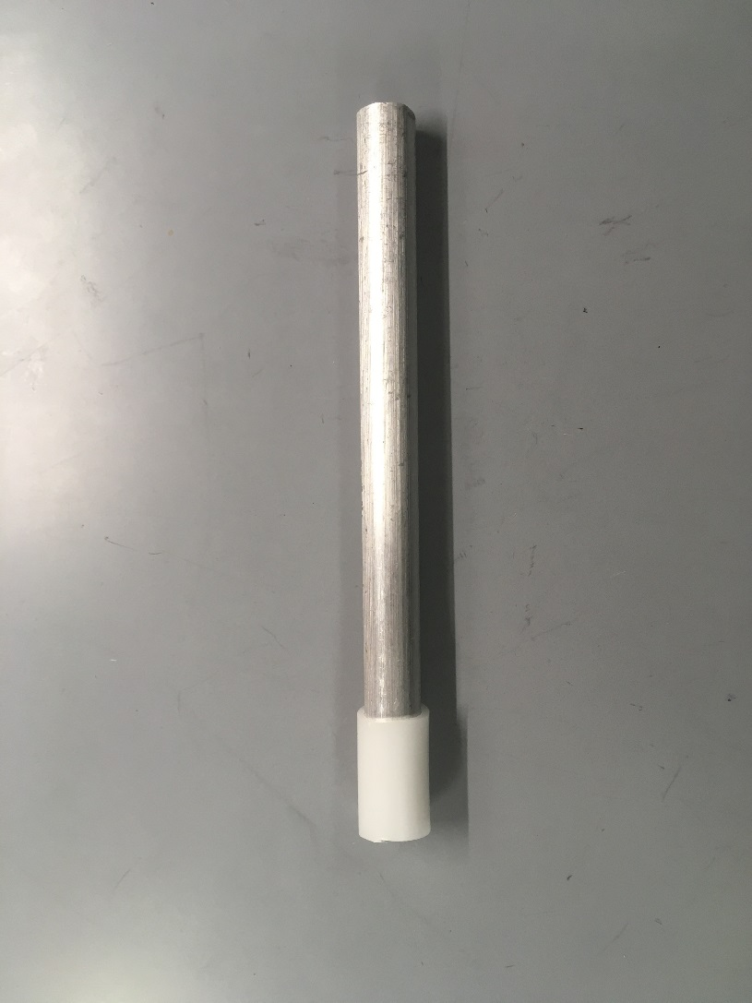
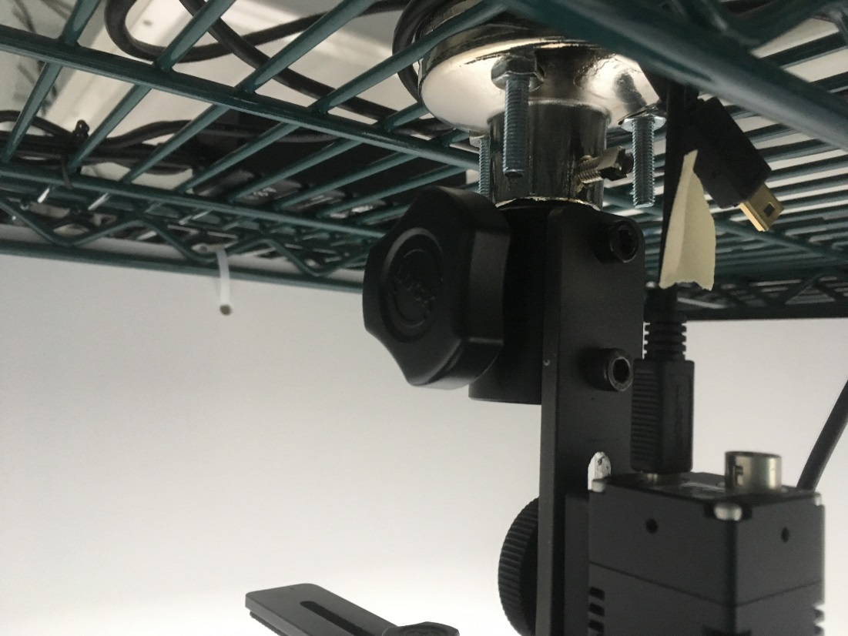
A
B
C
barrel
plastic sleeve
Step 2: Attach the L-bracket to the visible light ring (A) such that when camera is attached, it will be centered in the light ring opening (don’t attach yet).
Step 3: Insert the end of the aluminum rod with the plastic sleeve (B) into the barrel attached to the L-bracket and tighten in place.
Step 4: Slide the aluminum rod through the flanges and tighten set nuts with the provided Allen wrench to securely hold the light ring centered below the top shelf (C, so centered over the middle shelf where the arena will sit).

Slide 4
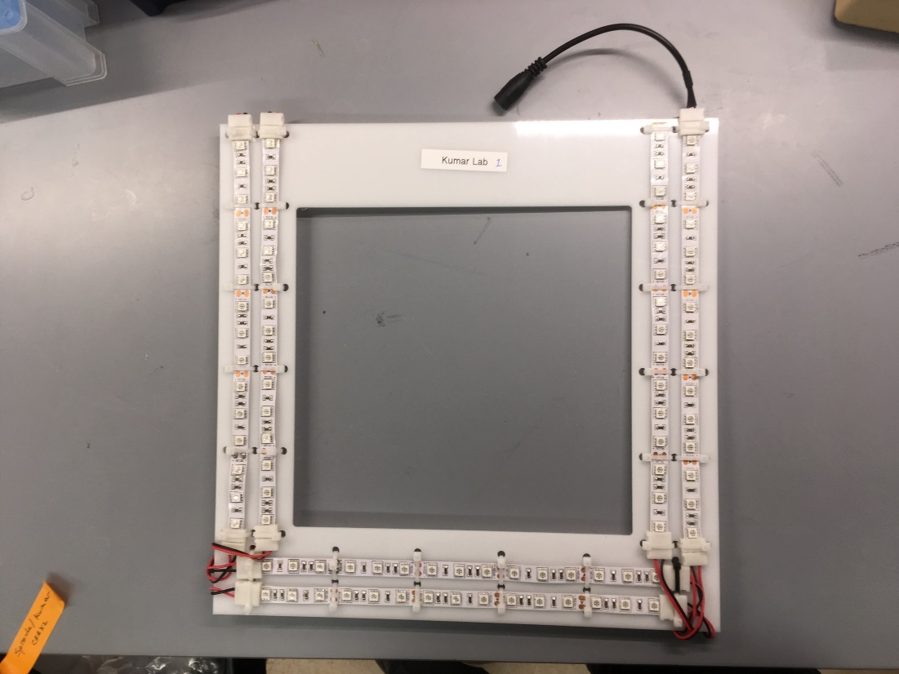
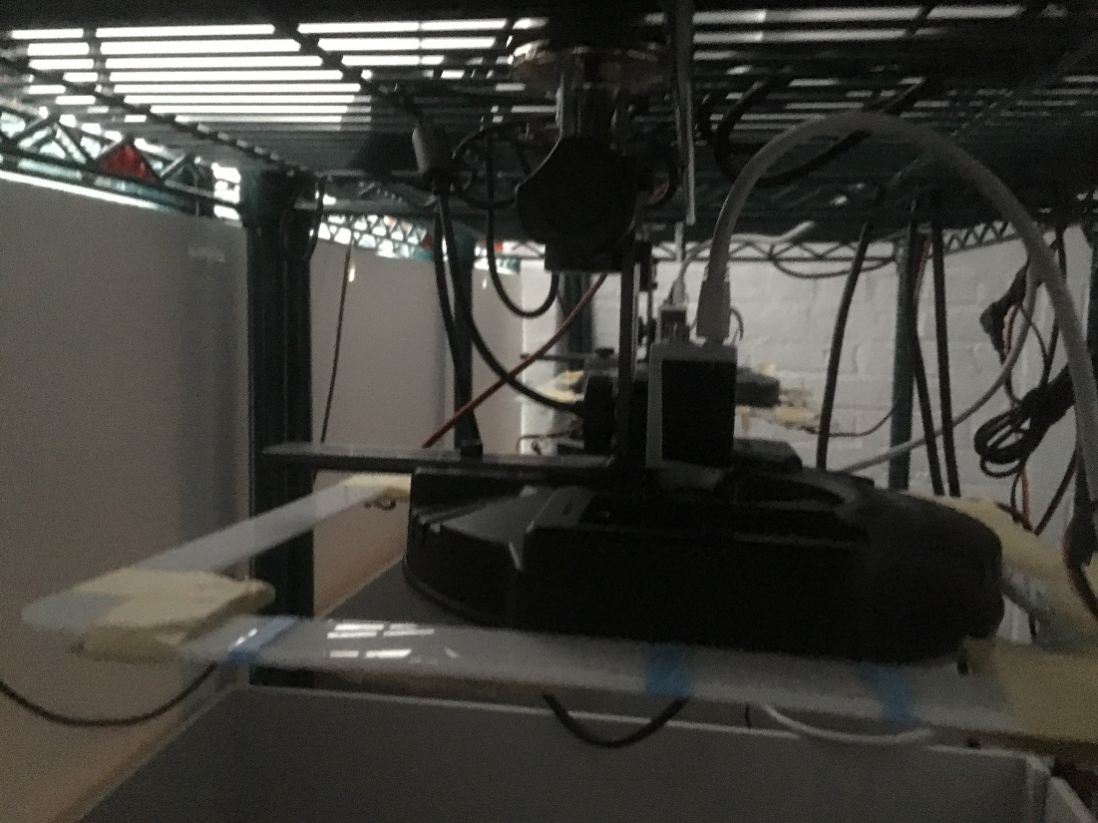
Step 5: slide the NIR light square over the visible light ring so it rests on the lip of the light ring with the NIR LED side down. We usually do this so the portion of the square without light strips (arrow) is at the back end of the setup.

Slide 5
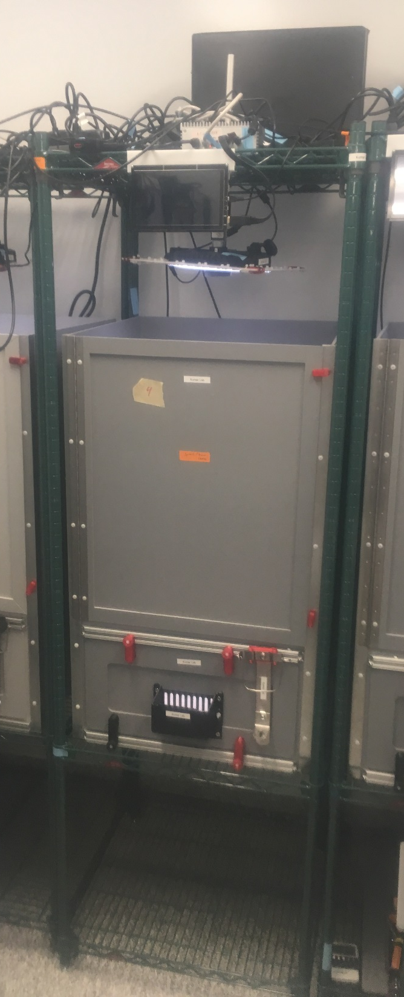
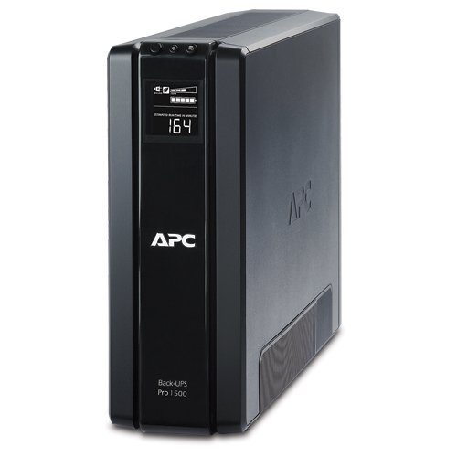
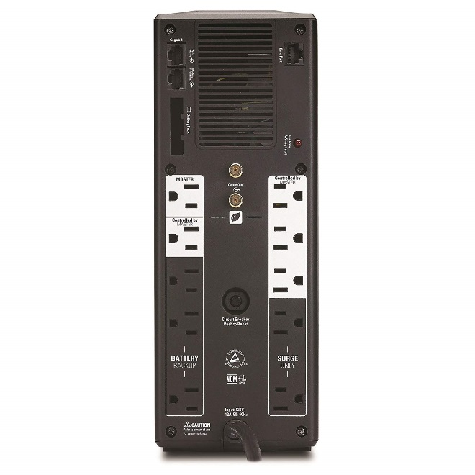
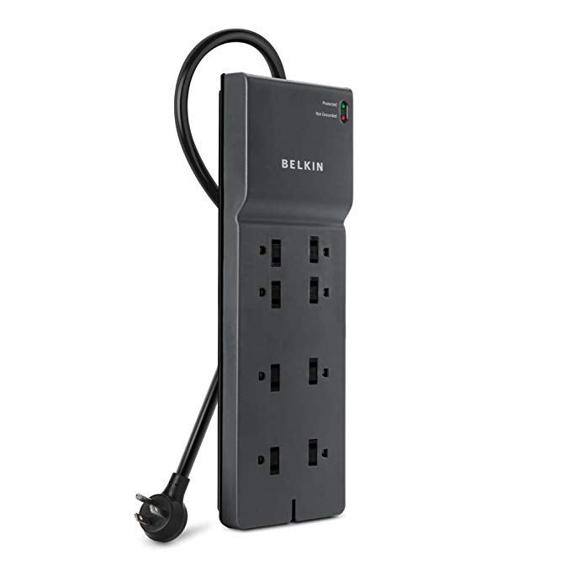
APC
APC front
APC back
Power strip
Step 6: If an APC is being used, place it on the top or bottom shelf (horizontal or vertical, after inserting its battery in the correct orientation), toward the back of the setup, so there will be room in the front for attaching other electrical items.
Step 7: Plug the APC into the wall, turn it on and silence the volume.
Step 8: Plug the power strip into one of the ‘Battery backup’ outlets of the APC (arrow) or into a regular power outlet if no APC is to be used. Power strip will be on top shelf, whether APC is on top or bottom.

Slide 6
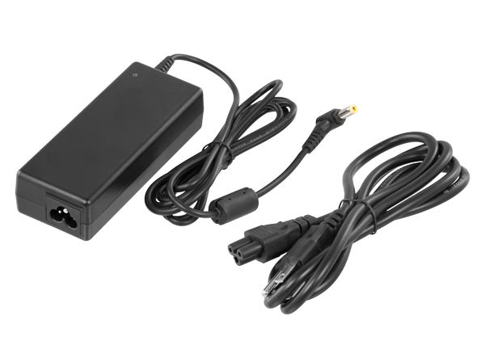
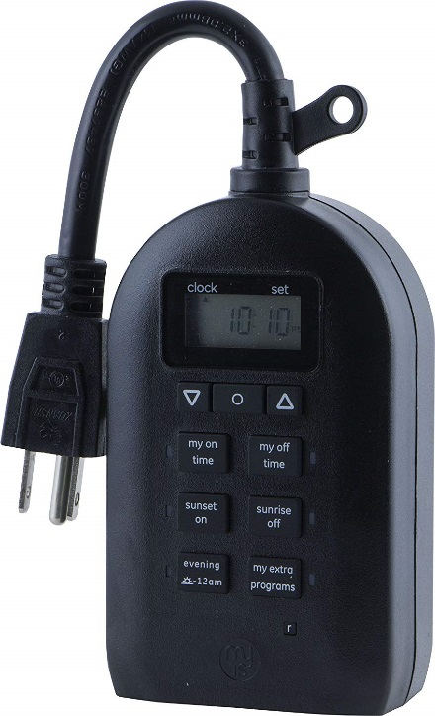
NIR light square
Power supply (same for both visible light ring and near infrared (NIR) light square)
Visible light ring
Step 9: Attach a power supply to the visible light ring and plug it into the timer. Plug the timer into the power strip (or ‘battery backup’ outlet of APC – see note).
Step 10: Attach a power supply to the NIR square and plug it into the power strip (not through the timer – the visible light ring is the only item on the timer).
Step 11: Set the current time, time on and time off on the timer. If the timer includes date controls, set to the correct date.
Note: If placing two setups side-by-side, one APC and Power Strip can be used for both. In that case, plug the timer directly into a ‘battery backup’ outlet of the APC, so there will be enough Power Strip outlets for all other items.
timer

Slide 7
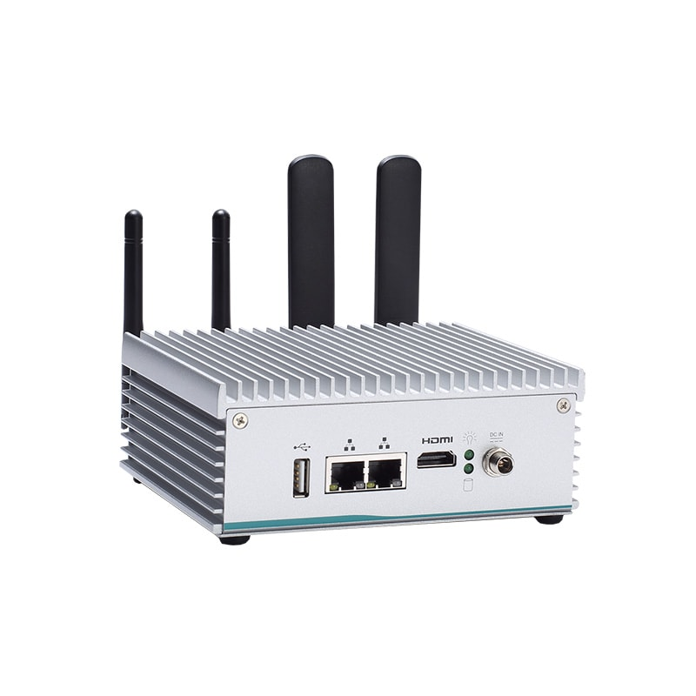
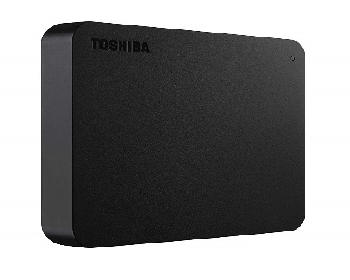
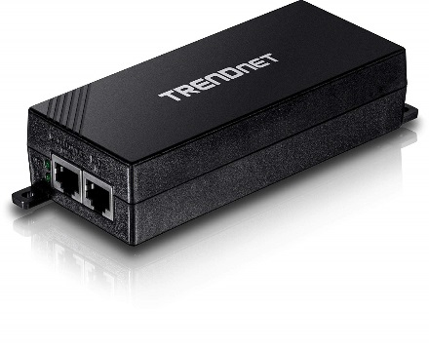
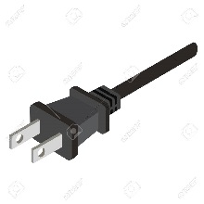
PoE+
4TB hard drive
TX2
Power strip
Step 12: Place the TX2 computer, 4TB hard drive and Trendnet PoE all on the top rack.
Step 13: All of these except the hard drive include power supplies. Plug all of them into the power strip.

Slide 8
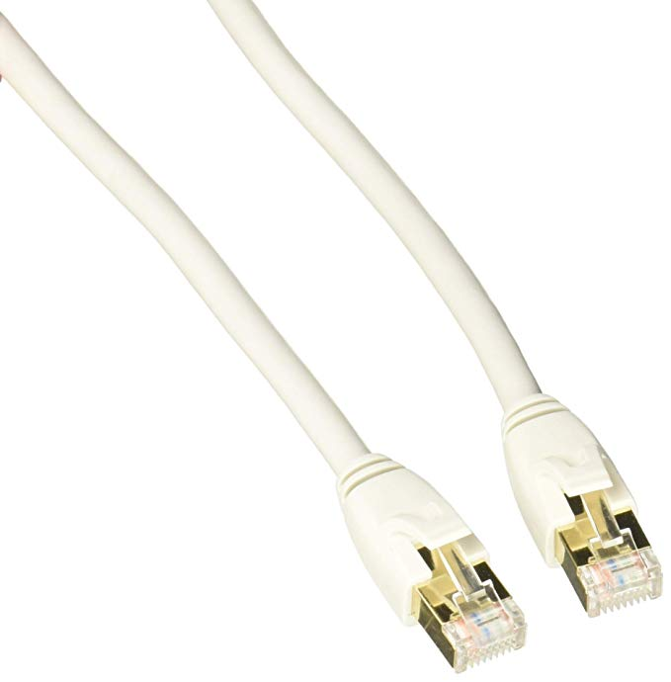
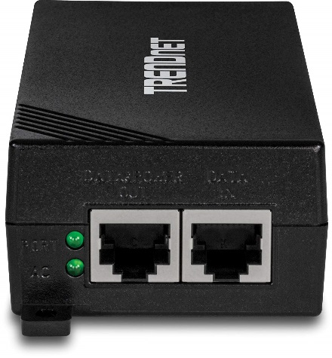
PoE+
Ethernet cables
TX2
Ethernet
To camera
To wall Ethernet port, if being used.
USB
Step 14: External hard drive to the TX2 (green).
Step 15: Attach Ethernet as shown. Place cable for camera to where the camera will go.
Step 16: Attach Ethernet cable from TX2 to wall outlet or network switch.
4TB hard drive

Slide 9
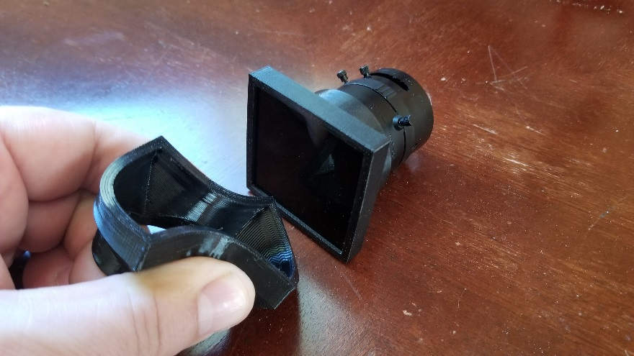
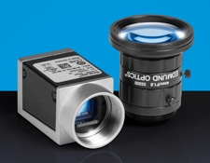
Knob to attach camera to L-bracket
Ethernet
Knob
Camera
Step 17: Place the IR filter in the square Ninjaflex holder and slide onto the lens. Attach the lens to the camera and the camera to the L-bracket using the knob provided.
Step 18: Attach the Ethernet cable from the TX2 to the camera
Ninjaflex holder, IR filter and lens
camera

Slide 10
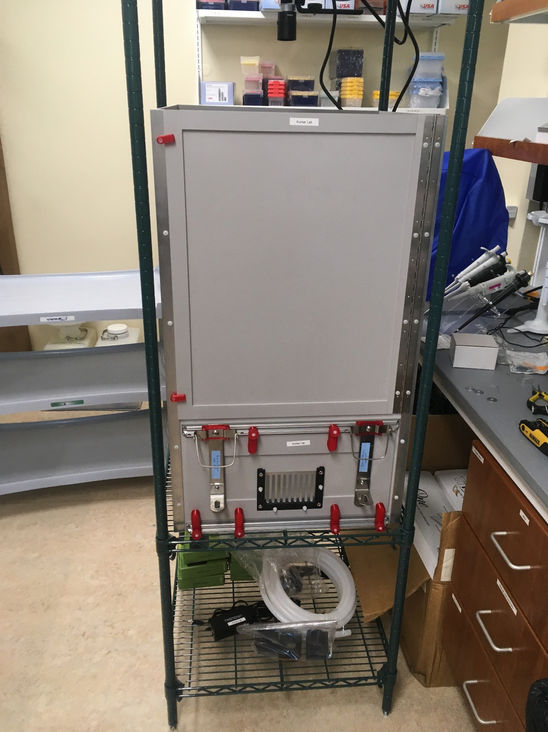
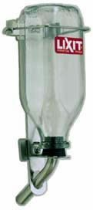
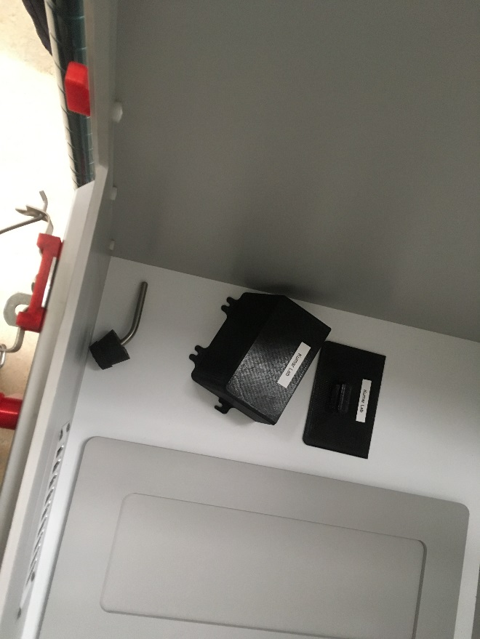
Step 19: Place the arena box on the rack. It includes two panel choices for the front of the box, attached by knobs (red) to rails above and below the panel.
The panel shown includes a food grate and holes for water bottle sipper tubes. Use the plain front panel if you will not be providing external food and water, including when feeding via Dietgel.
Food hopper
Hopper lid
Water bottle sipper tube
Plain front panel
Water bottle in holder

Slide 11
Step 20: Using a light meter reading at the center of the floor, adjust the visible light strength to the desired amount (i.e. 350 +/- 10 lux).

Slide 12
Step 21: Interacting with the Computer.
The computer will turn on when you give it power. To turn it off, simply unplug the power. (Do NOT unplug during an experiment as you will lose data.)
Login credentials:
Username: nvidia
Password: nvidia
Connect a keyboard, mouse, and monitor for accessing local setup.
Alternatively, you can run the software via remote access with another computer (Recommended alternative) or run a trial experiment via the web UI (Not recommended). If you run a trial experiment, there will be a stream delay between adjusting focus and observing changes.
Recommended remote software includes “ssh -X” on linux/mac and “mobaxterm” on windows. Note that Mac will need a x-server running to interact with GUI software.
TX2
Power Plug

Slide 13
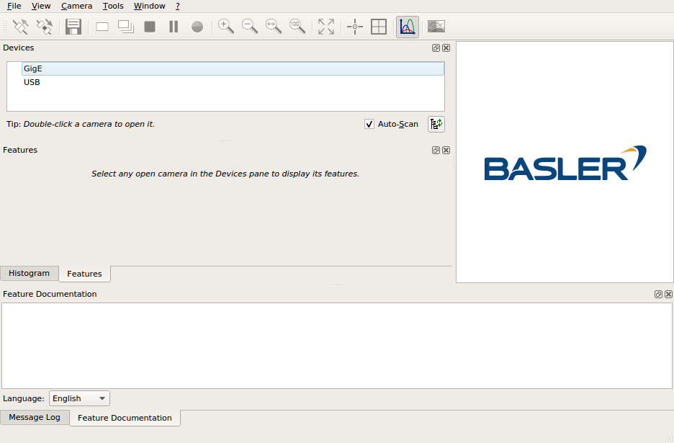
Step 21: Open the program called “PylonViewerApp” via running the following terminal command: /opt/pylon5/bin/PylonViewerApp
* Note: To run a terminal command with a screen/keyboard connected directly to the device, log in and start the program “terminal”.
Step 21a: Double click on the camera device to open it. There should only be one device connected (if not, double check the camera Ethernet cables).

Slide 14
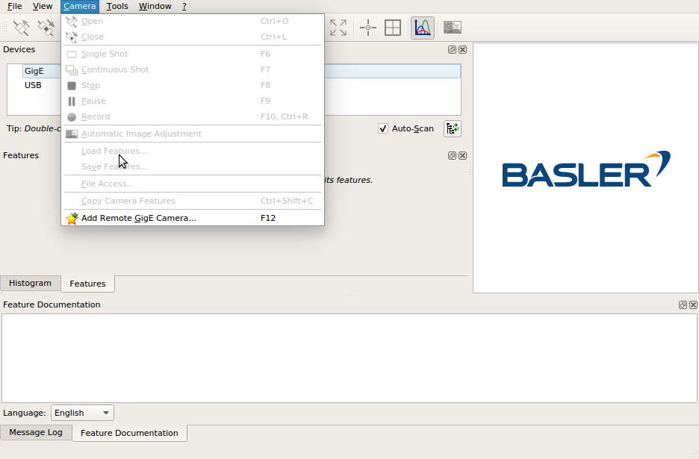
Step 22: Load the settings for the camera.
On the top menu, select Camera -> Load Features.
If you are using a keyboard, the shortcuts are: Alt -> C -> L
Select the settings saved in the folder on the desktop.

Slide 15
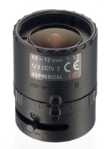
Lens Control Knobs
Focus Adjustment Knob
Aperture Adjustment Knob
Zoom Adjustment Knob
Knobs unlock by rotating counter-clockwise and lock by rotating clockwise.

Slide 16
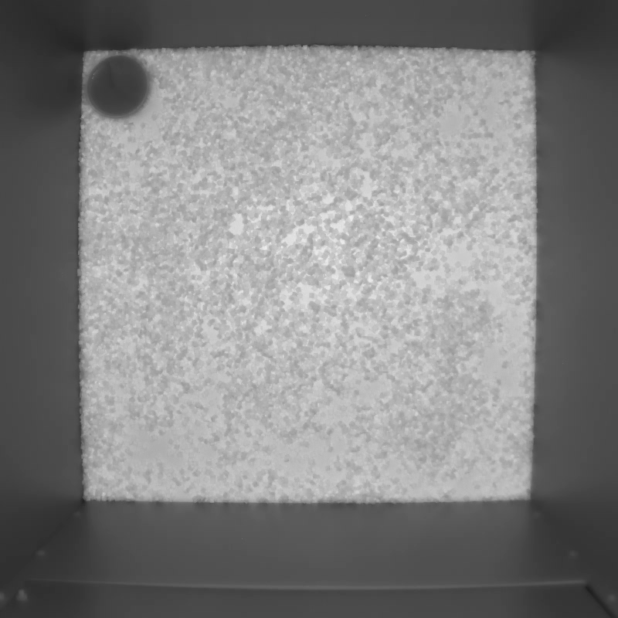
Step 23: Adjusting the Focus
In the main window, start a live-view of the camera by clicking the red circled icon (or F7 keystroke).
A window will appear on the right, which you should maximize.
Adjust the lens zoom such that there is a small border of gray wall around the entire arena.(example shown)
After zoom is adjusted, adjust the focus such that the image is in focus. To better see detail, digitally enlarge the viewed image (note bottom left).
Aperture should be adjusted to be between 75% and 50% closed. When fully closed, no light should get through.
You can zoom in and out with the tools outlined in green. Additionally, keystrokes [ctrl, shift, and +] will zoom in while [ctrl and -] will zoom out. Clicking and dragging on the image will pan.

Slide 17
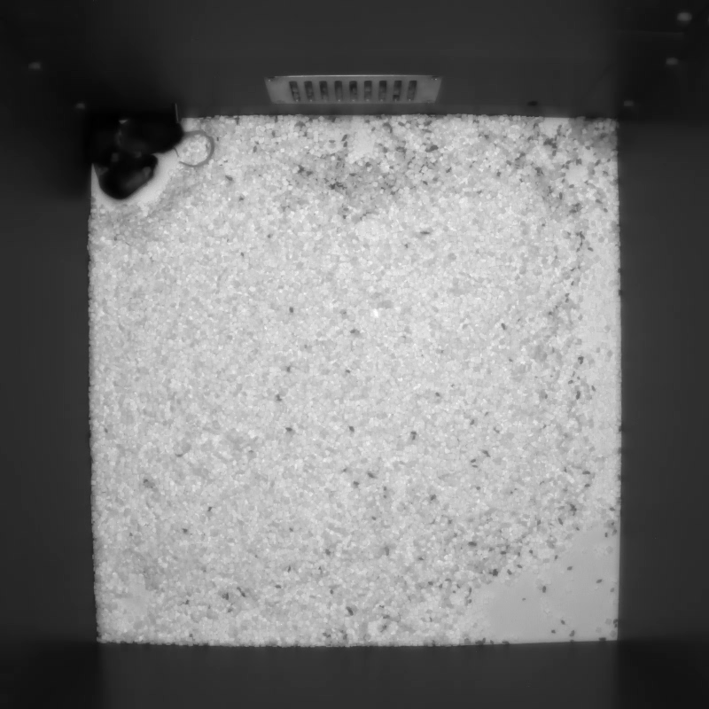
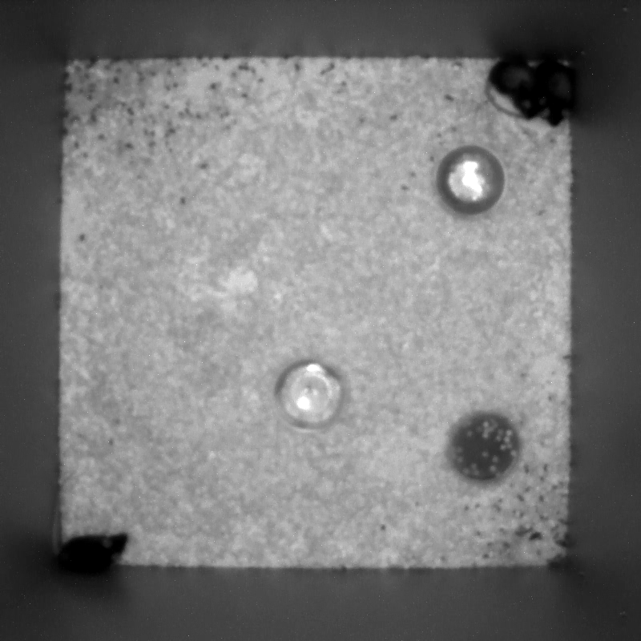
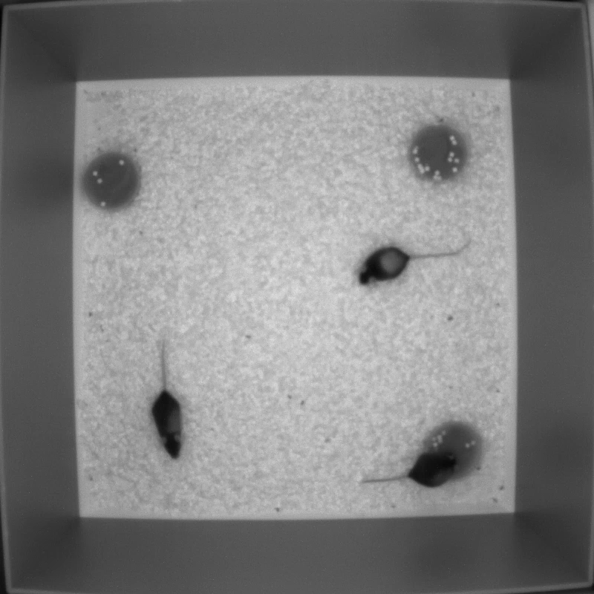
Zoomed in examples
In focus Examples
Out of Focus Examples

Slide 18
You can close the focusing software and you are now ready to record videos.

Slide 19
List of changes:
2019 to 2021-09-22:
Remove screen
Remove USB hub (hard drive directly into device)
Adjusted interacting with the computer to be remote-based

